Slide 1
INSERTION SORT

Slide 2
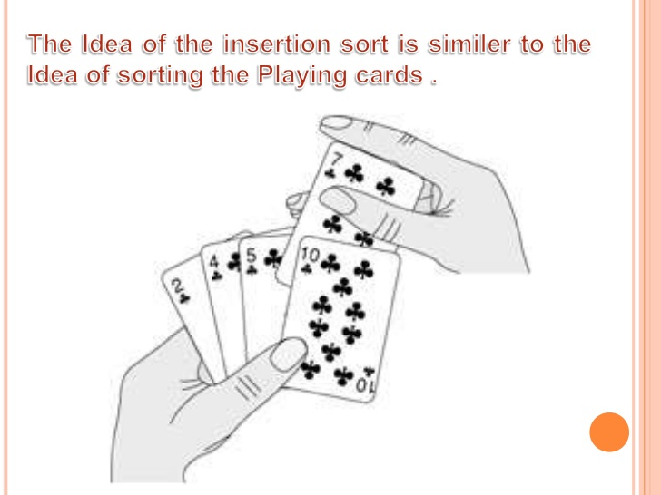

Slide 3
Insertion Sorting
It is a simple Sorting algorithm which sorts the array by shifting elements one by one. Following are some of the important characteristics of Insertion Sort.
It has one of the simplest implementation
It is efficient for smaller data sets, but very inefficient for larger lists.
Insertion Sort is adaptive, that means it reduces its total number of steps if given a partially sorted list, hence it increases its efficiency.
It is better than Selection Sort and Bubble Sort algorithms.
Its space complexity is less, like Bubble Sorting, insertion sort also requires a single additional memory space.
It is Stable, as it does not change the relative order of elements with equal keys

Slide 4
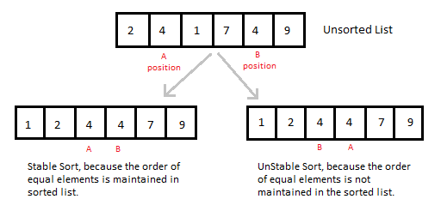

Slide 5
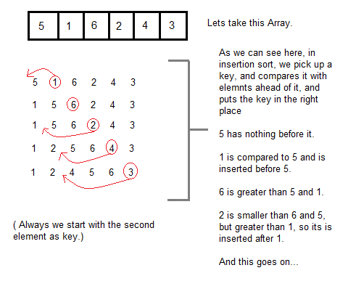
How Insertion Sorting Works

Slide 6
Insertion Sort
Example :
9
2
7
5
1
4
3
6

Slide 7
Insertion Sort
Sorted section
9
2
7
5
1
4
3
6
We start by dividing the array in two sections: a sorted section and an unsorted section. We put the first element as the only element in the sorted section, and the rest of the array is the unsorted section.

Slide 8
Insertion Sort
Sorted section
Item to position
9
2
7
5
1
4
3
6
The first element in the unsorted section is the next element to be put into the correct position.

Slide 9
Insertion Sort
Item to position
9
2
7
5
1
4
3
6
2
We copy the element to be placed into another variable so it doesn’t get overwritten.

Slide 10
Insertion Sort
9
2
7
5
1
4
3
6
2
compare
If the previous position is more than the item being placed, copy the value into the next position

Slide 11
Insertion Sort
belongs here
9
9
7
5
1
4
3
6
2
If there are no more items in the sorted section to compare with, the item to be placed must go at the front.

Slide 12
Insertion Sort
2
9
7
5
1
4
3
6

Slide 13
Insertion Sort
2
9
7
5
1
4
3
6

Slide 14
Insertion Sort
Item to position
2
9
7
5
1
4
3
6

Slide 15
Insertion Sort
2
9
7
5
1
4
3
6
7
compare

Slide 16
Insertion Sort
Copied from previous position
belongs here
2
9
9
5
1
4
3
6
7
compare
If the item in the sorted section is less than the item to place, the item to place goes after it in the array.

Slide 17
Insertion Sort
2
7
9
5
1
4
3
6

Slide 18
Insertion Sort
2
7
9
5
1
4
3
6

Slide 19
Insertion Sort
Item to position
2
7
9
5
1
4
3
6

Slide 20
Insertion Sort
2
7
9
5
1
4
3
6
5
compare

Slide 21
Insertion Sort
2
7
9
9
1
4
3
6
5
compare

Slide 22
Insertion Sort
belongs here
2
7
7
9
1
4
3
6
5
compare

Slide 23
Insertion Sort
2
5
7
9
1
4
3
6

Slide 24
Insertion Sort
2
5
7
9
1
4
3
6

Slide 25
Insertion Sort
Item to position
2
5
7
9
1
4
3
6

Slide 26
Insertion Sort
2
5
7
9
1
4
3
6
1
compare

Slide 27
Insertion Sort
2
5
7
9
9
4
3
6
1
compare

Slide 28
Insertion Sort
2
5
7
7
9
4
3
6
1
compare

Slide 29
Insertion Sort
2
5
5
7
9
4
3
6
1
compare

Slide 30
Insertion Sort
belongs here
2
2
5
7
9
4
3
6
1

Slide 31
Insertion Sort
1
2
5
7
9
4
3
6

Slide 32
Insertion Sort
1
2
5
7
9
4
3
6

Slide 33
Insertion Sort
Item to position
1
2
5
7
9
4
3
6

Slide 34
Insertion Sort
1
2
5
7
9
4
3
6
4
compare

Slide 35
Insertion Sort
1
2
5
7
9
9
3
6
4
compare

Slide 36
Insertion Sort
1
2
5
7
7
9
3
6
4
compare

Slide 37
Insertion Sort
belongs here
1
2
5
5
7
9
3
6
4
compare

Slide 38
Insertion Sort
1
2
4
5
7
9
3
6

Slide 39
Insertion Sort
1
2
4
5
7
9
3
6

Slide 40
Insertion Sort
Item to position
1
2
4
5
7
9
3
6

Slide 41
Insertion Sort
1
2
4
5
7
9
3
6
3
compare

Slide 42
Insertion Sort
1
2
4
5
7
9
9
6
3
compare

Slide 43
Insertion Sort
1
2
4
5
7
7
9
6
3
compare

Slide 44
Insertion Sort
1
2
4
5
5
7
9
6
3
compare

Slide 45
Insertion Sort
belongs here
1
2
4
4
5
7
9
6
3
compare

Slide 46
Insertion Sort
1
2
3
4
5
7
9
6

Slide 47
Insertion Sort
1
2
3
4
5
7
9
6

Slide 48
Insertion Sort
Item to position
1
2
3
4
5
7
9
6

Slide 49
Insertion Sort
1
2
3
4
5
7
9
6
6
compare

Slide 50
Insertion Sort
1
2
3
4
5
7
9
9
6
compare

Slide 51
Insertion Sort
belongs here
1
2
3
4
5
7
7
9
6
compare

Slide 52
Insertion Sort
1
2
3
4
5
6
7
9

Slide 53
Insertion Sort
1
2
3
4
5
6
7
9
SORTED!

Slide 54
